Slide 1
Team-1
Retail

Slide 2
DataLake – Retail Folder Structure
Raw Zone(Landing Zone)​​
​​
Structure:​
/raw/​​
/Online​​
Sales
Transactions
Clickstreams​​
Customer-feedback​​
/In-store​​
Sales​​
Inventory​​
Customer-surveys​​
/Mobile-app​​
User-sessions​​
Sales
Transactions​​
App-feedback​​
Curated Zone​​
Structure:​
/curated/​
/Sales​​
Online​​
In-Store​​
Mobile-app
​​
/Marketing
campaign-performance
customer-segmentation
​​
/Inventory
stock-levels
supply-chain
/customer
customer-360
loyalty-program​​
Consumption Zone​​
​​
Structure:​
/consumption/
/Reports
weekly-marketing
daily-sales
monthly-inventory
/In-store​​
executive-dashboard
inventory-dashboard
/Data-feeds
partner-data
third-party-integrations
Archive Zone​​
​​
Structure:​
/archive
/Online​​
raw
curated
consumption
​​

Slide 3
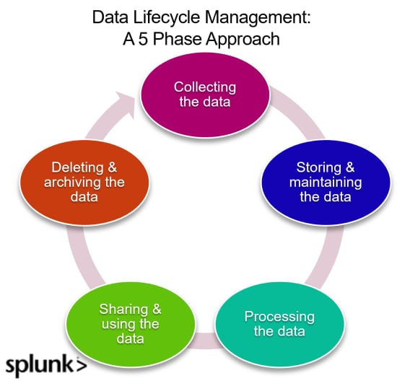
Data Lifecycle Management (DLM)
• Data Extraction:
-The first step is to extract data from the web app's database
• Data Transformation :
-Data is transformed into a suitable format (like CSV, Parquet, or JSON)
• Data Processing and Analysis:
-This phase uses data for operational tasks, decision-making, sales analytics, and reporting within the retail application.
• Data Sharing and Distribution:
-Securely share data with teams, partners, or customers, preventing unauthorized access.
Data Archiving
-Data no longer in active use but required for legal or historical reasons is moved to cost-effective long-term storage
Data Deletion:
-This phase involves permanently deleting data that is no longer needed or required

Slide 4
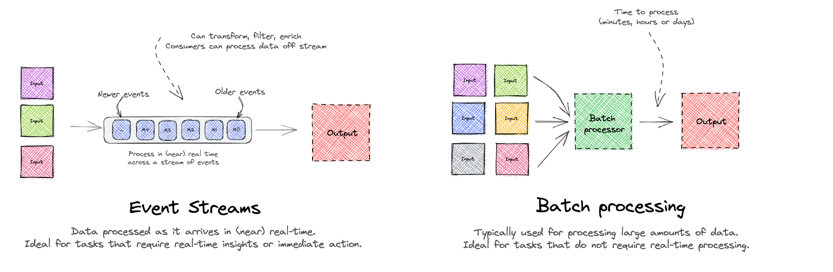
Batch Vs Stream Processing Flow

Slide 5

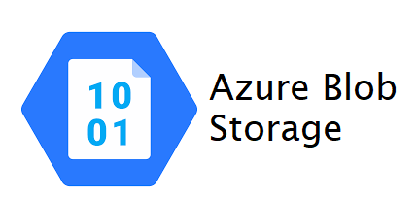

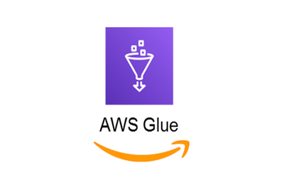


Applications
Tools
Stream Processing:
Realtime Product Recommendations
Stock Management
Advertisement Optimization
Batch Processing:
Channel Performance
Sales Analysis

